Slide 1
CONTRIBUTION OF SCIENCE TO IMPROVE SPORTING PERFORMANCE
How does science improve sports capabilities ?
PROU Léa & TAGEDDINE Inès

Slide 2
Biological (physical) factors
different performance factors
Technical factors (strategic)
Psychological factors
Social factors
Factor of luck

Slide 3
Some Sciences allow to develop these notions such as :
The physiology
The anatomy
Biochemistry

Slide 4
The great discoveries that have emerged from this research are :
Structure and muscular functioning
energetic metabolism of the muscle
the nervous control of the movement
hormonal regulation during the exercise
energy expenditure, nutrients used during the exertion
the cardiorespiratory system and its Control

Slide 5
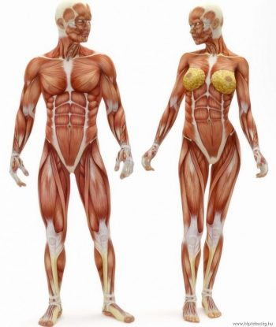
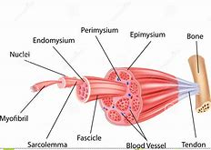
Muscle
The physiology of the muscle
The structure of skeletal muscle

Slide 6
• The different energy regeneration pathways:
The muscle cell has three regeneration pathways :
The aerobic pathway (presence of oxygen), pathway of cellular respiration. (ex: 5000m)
The anaerobic (no oxygen) pathway, lactic fermentation pathway. (ex 400m)
The anaerobic (in absence of oxygen) alactique route , pathway of phosphocreatine, pathway of immediate regeneration. (ex: 100m)

Slide 7
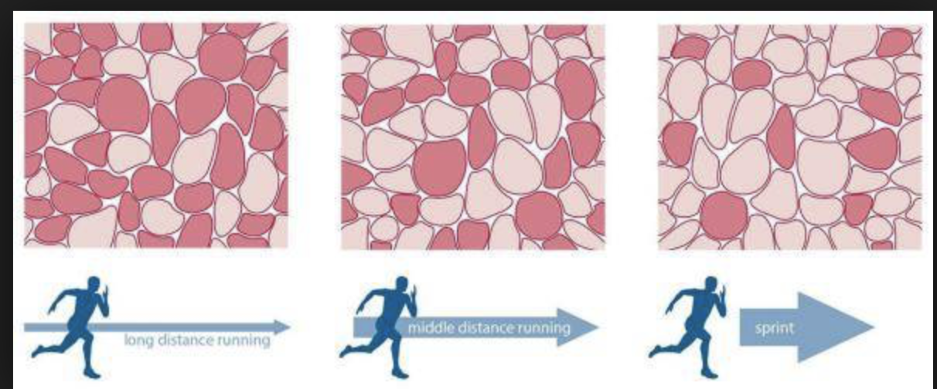
Different types of muscle fibers:
There are three types of muscle fibers:
Type I Type IIa Type IIb

Slide 8
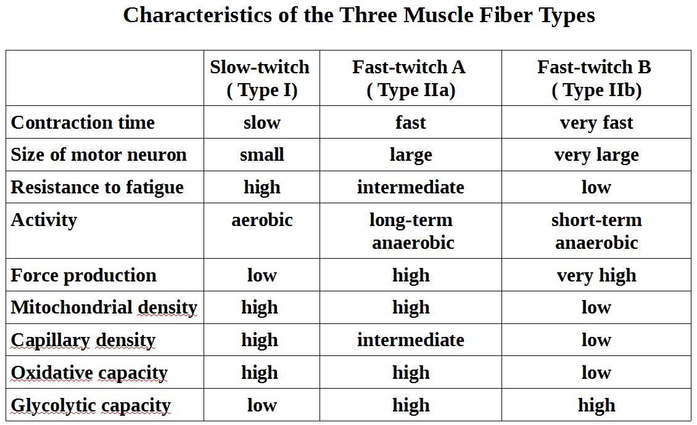
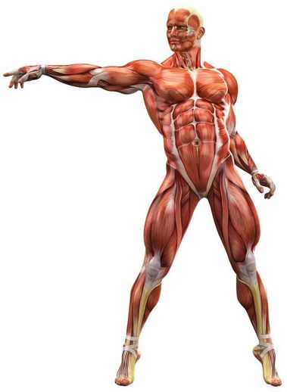

Slide 9
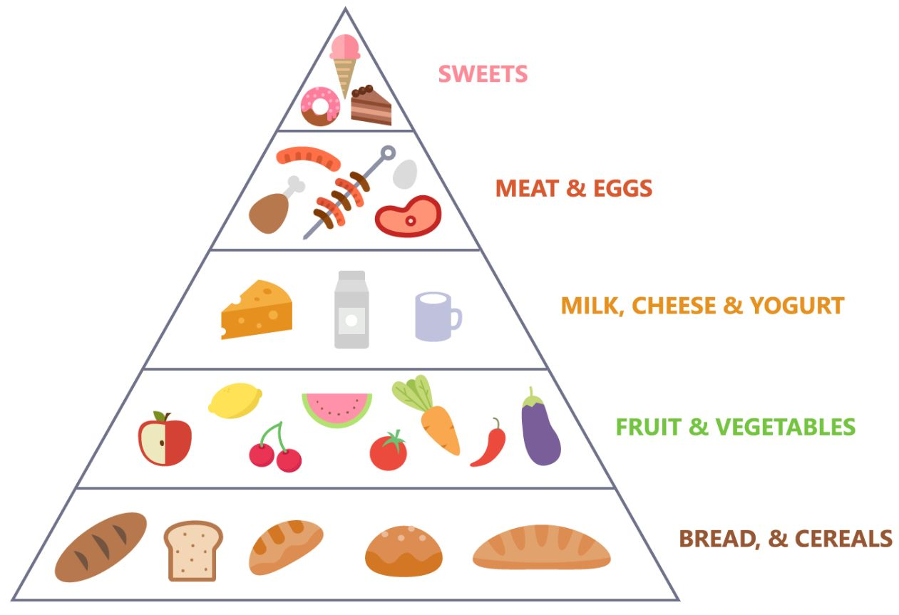
The food pyramid

Slide 10
food supplements

Slide 11
• Adaptation of the body during aerobic training (in the presence of oxygen)
use of circulating fatty acids (preferential substrate)
adaptation of the cardiovascular function to the effort (decreased resting heart rate and resting blood pressure)
Increase of maximum oxygen volume (VO2max)
increase in muscular blood flow (better intakes of oxygenated blood to the muscle)
Increase in the share of type I fibres
delayed lactic threshold (best stress tolerance)

